Slide 1



Applying the Quality Function Deployment Method to Explore Service Quality Strategies for Smart Airports Utilizing Technology
Advisor: Sheng-Teng Huang
Reporter: Chun Yang Chiu
Conference: The WEI Singapore 2026
Date: 2-5 February 2026

Slide 2


Bio Note
Chun Yang Chiu
Sheng-Teng Huang
Chun Yang Chiu is a master’s student in the Department of Transportation Science at the College of Maritime Science and Management, National Taiwan Ocean University (NTOU).
He is Sheng Teng Huang’s student. His recent research focused on Smart airports.
• Dr. Sheng Teng Huang is an Associate Professor in the Department of Transportation Science at the College of Maritime Science and Management, National Taiwan Ocean University (NTOU).
• Prior to his current position, he worked at Inchcape Shipping Service (ISS) in Singapore (stationed at both the Asia Pacific office in Tanjong Pagar) and the Taipei office.
• He earned his PhD in maritime logistics from Kobe University, Japan, under the supervision of Professor Yoshida Shigeru. His primary research interests encompass the Japanese shipping industry, logistics, and delivery management.

Slide 3

Contents
Chapter 1. Introduction
Chapter 2. Literature Review
Chapter 3. Methodology
Chapter 4. Result and discussion
Chapter 5. Conclusion

Slide 4
01 Introduction

Slide 5
The Post-Pandemic Aviation Landscape
1.7B
4.7B
176%
2020 Passengers
2024 Passengers
Growth Rate
Global air traffic at pandemic low
Surpassing pre-pandemic levels
Recovery and expansion combined
The rapid recovery of global air passenger traffic has created unprecedented challenges. Airports worldwide are experiencing severe congestion, leading to declining service quality and operational bottlenecks. This research addresses the critical need for smart technology solutions to accommodate this explosive growth.

Slide 6
Research Objectives
01
02
03
Identify Key Service Attributes
Define Technical Requirements
Prioritize Technology Implementation
Determine the most critical service quality factors from both passenger and airline perspectives through comprehensive stakeholder analysis.
Map essential technical capabilities needed to support digital transformation and modernization initiatives at smart airports.
Apply Multilayer Quality Function Deployment (QFD) methodology to create a data-driven prioritization framework for smart technology adoption.

Slide 7
Research Structure
1.Establish the research objectives based on the research background and motivation.
2.Identify the needs of airport passengers, the needs of airlines, and the technological requirements of smart airports through a literature review.
3.Apply Importance–Performance Analysis to derive the standardized weights of airport passengers and airlines, and then construct a conflict matrix to balance the service demand conflicts between the two parties.
4.Complete the cross-synthesis of the conflict matrix, incorporate the weights into the corresponding Houses of Quality for airport passenger and airline needs, and, after expert review, obtain the relationship matrices between service requirements and technological requirements.
5.Develop the third-dimension evaluation and calculate the importance weights of technological requirements
6.Determine the priority order for implementing smart airport technological requirements
7.Propose conclusions and recommendations

Slide 8
02 Literature Review

Slide 9
Definition of Smart Airport
The main components of smart airport functions include aviation security, passenger convenience, operational efficiency, and the optimization of limited resources. Each component aims to simplify processes through modern technologies in order to achieve comfortable and efficient operations (Aruna Rajapaksha et al., 2020).
A smart airport leverages modern information technologies to optimize processes, analyze data, and integrate emerging technologies, thereby continuously promoting and enhancing airport services, operational performance, and passenger satisfaction. Smart check-in, self-service boarding, indoor navigation, biometric services, smart wearable devices, RFID baggage tags, self-service baggage tagging, self-service terminals for lost baggage, border control systems, and airport mobile applications can all be regarded as application tools of smart airports (Aruna Rajapaksha et al., 2020).

Slide 10
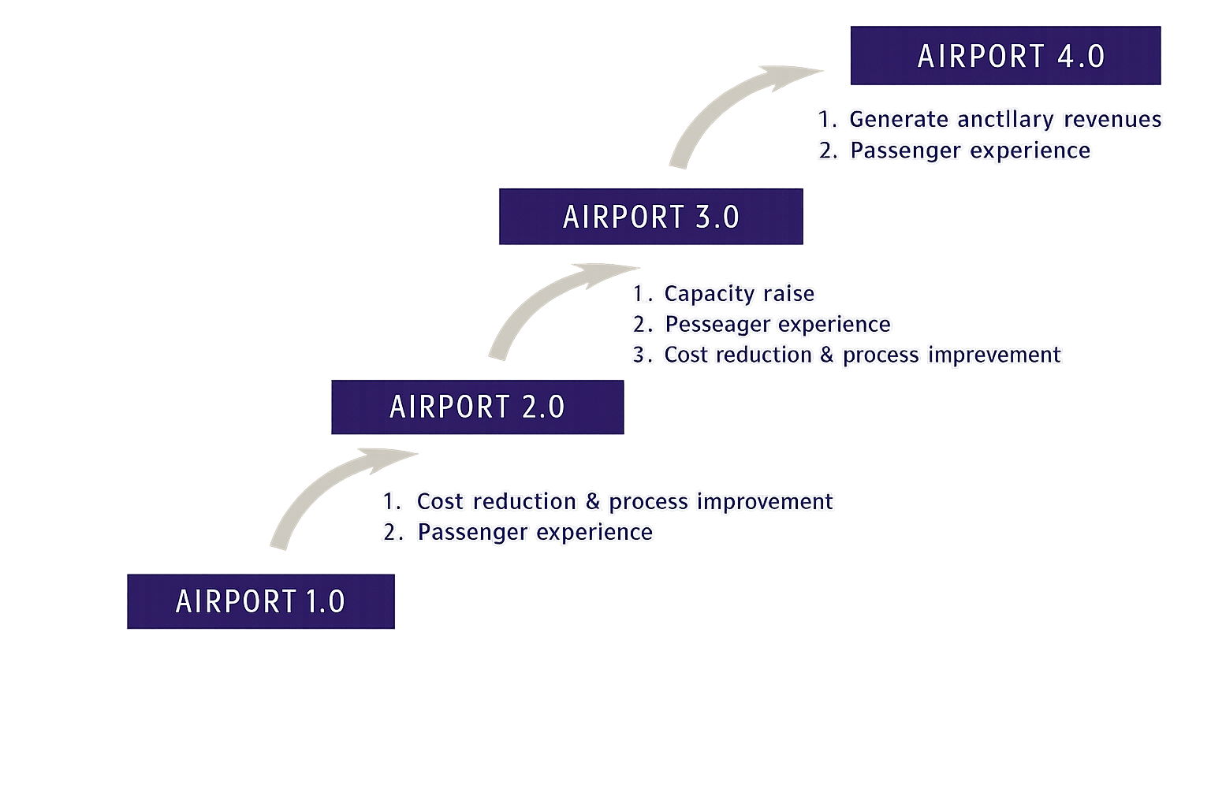
Development of Smart Airport
The level of technological development at an airport can be referred to as digital maturity, and airport technological development can be classified into four stages: Airport 1.0, 2.0, 3.0, and 4.0 (Nau & Benoit, 2017).
Airport 4.0 represents a concept that leverages big data and open data to enhance innovation capabilities (Bouyakoub et al., 2017). In such airports, operators collect and analyze real-time passenger service process data to generate value and improve operational efficiency.
Level of Technology Adaptation in Airports (Nau & Benoit, 2017)

Slide 11
Global Development Trends
Japan (MLIT)
South Korea (MOLIT)
Face Express & Fast Travel
Hands-free Travel Initiative
Japan wants to achieve a stress-free and comfortable travel environment and to provide user services at a world-class level, advanced technologies will be utilized to enhance and streamline the various procedures required of passengers as well as their movement flows within the airport. Such as Automation of airport ground handling operations, AI security screening and One-ID biometric systems.
Korea points out that, in response to the demand for contactless services in the post-pandemic era and the development of Fourth Industrial Revolution technologies, airports must be transformed into high-tech smart airports. Empty-hand travel service, is one of their plans.

Slide 12
03 Methodology

Slide 13
Importance performance analysis (IPA)
Martilla and James 1977, this method is used to assess customer satisfaction and prioritize areas for improvement. It has since been widely applied in various fields such as service quality management, product development, and strategic planning.
Keep up with the good work
Concentrate here
Importance
Low Priority
Possible overkill
Performance

Slide 14
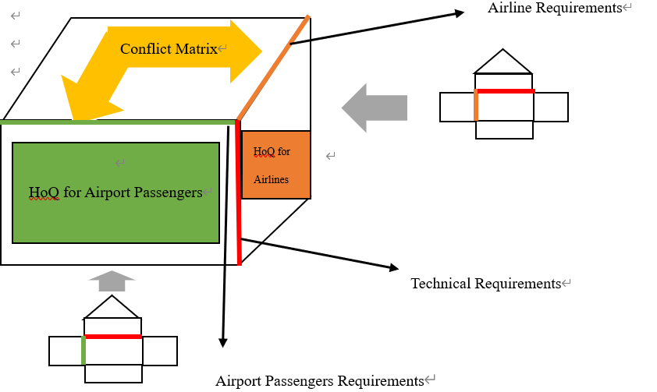
Multi-layer Quality Function Deployment
Duru et al. (2013) proposed 'Multi-layer Quality Function Deployment,' which integrates the needs of both customers and service providers into a unified decision-making framework to reach a final solution that balances both viewpoints.

Slide 15
Demand of Passenger for Smart airport
Passenger Service Attributes | Definition | Source
1. Reducing Waiting Time | Refers to the total time passengers spend in essential processes such as check-in, passport control, and security screening. | Sema Kayapınar., et al. (2019)
2. Baggage Handling Safety and Efficiency | Measures the speed and efficiency of the baggage check-in and reclaim process; high-efficiency systems and rapid delivery enhance passenger satisfaction. | Emrah Bulut., et al. (2018)
3. Ground Transportation and Airport Accessibility | Evaluates the transportation options available to passengers and the ease and speed of movement within the terminal. | Sema Kayapınar., et al. (2019)
4. Clarity of Signage and Directions | Measures the ease with which passengers can find their destinations within the terminal, as well as the clarity and directionality of the signage system. | Emrah Bulut., et al. (2018)
5. Enhancing Safety and Security Levels | Evaluates the passenger's sense of security regarding airport security measures and facilities. | Emrah Bulut., et al. (2018)
6. Touchless Services | Refers to post-pandemic hygiene requirements, focusing on the use of technology to reduce physical contact between passengers and staff or facilities. | Yirui Jiang., et al. (2023)
7. Staff Service Quality and Courtesy | The degree of politeness, friendliness, helpfulness, and proactiveness exhibited by airport staff, check-in counter personnel, or security officers. | Seock-Jin Hong., et al. (2024)
8. Terminal Cleanliness and Comfort | Refers to the cleanliness of the terminal and restrooms, as well as lighting and crowding levels. | Mahmut Bakır., et al. (2022)
9. Wi-Fi Connectivity | The availability and connection quality of the airport's Wi-Fi services. | Mahmut Bakır., et al. (2022)
10. Real-time Flight Information Display and Accuracy | The timeliness and accuracy of information updates regarding flight arrivals and departures. | Sooyoung Choi., et al. (2024)

Slide 16
Demand of Airlines for Smart airport
Airline Service Attributes | Definition | Source
1. Safe and Expedited Operations | Refers to aircraft operations on runways, taxiways, aprons, and parking stands, which must prioritize high speed and efficiency under the premise of high safety. | Emrah Bulut., et al. (2018)
2. Enhancing Overall Airport Operational Efficiency | Improving overall operational efficiency by optimizing resource utilization, process management, and shared situational awareness within the airport. | Sorin Eugen Zaharia., et al. (2018)
3. High-Efficiency Ticketing and Gate Management Processes | The efficiency and convenience of ticketing procedures and gate assignment services. | Emrah Bulut., et al. (2018)
4. Operator Responsiveness | The responsiveness and attitude of airport operators or management toward quality-of-service issues raised by airlines. | Jakob Trischler., et al. (2018)
5. Real-Time Information Exchange and Sharing | Breaking down information silos between different stakeholders to achieve real-time flow, integration, and application of data. | Sunbae Moon., et al. (2025)
6. Reduction of Service Fees and Charges | The expectation of airlines for airports to provide lower service fees and charges to reduce operational expenditures. | Emrah Bulut., et al. (2018)
7. Efficient Baggage Handling | High-efficiency, safe, and rapid baggage handling facilities and services. | Emrah Bulut., et al. (2018)
8. Airside Infrastructure Standards and Availability | The availability and service standards of runways, taxiways, and aprons, as well as compatibility with specific aircraft types (e.g., A380 series). | Mukesh Mohan Pandey (2020)
9. Flexibility in Flight Slot Allocation | Providing flexibility in flight slot assignments to accommodate airline scheduling demands. | Mukesh Mohan Pandey (2020)
10. Aircraft Maintenance and Logistics Support Capabilities | The airport's capability to provide or support aircraft maintenance and the timely delivery of spare parts to shorten maintenance lead times. | Mukesh Mohan Pandey (2020)

Slide 17
Technical requirements for Smart airport
Technical Requirements | Definition | Source
1. IoT Sensor Monitoring | Smart airports utilize IoT sensors to monitor the real-time location and status of ground support equipment (GSE), refueling vehicles, and cleaning staff, using AI algorithms for dynamic resource scheduling. | Yirui Jiang., et al. (2023)
2. 5G Network Technology | An indispensable assistant for smart airports; its characteristics of high bandwidth, low latency, and massive IoT connectivity are crucial for enhancing efficiency and service quality. | Sorin Eugen Zaharia (2018)
3. ONE-ID Facial Recognition | Passengers register their facial images to use a "Face Pass" for bag drop, security, and boarding gates, eliminating the need to present boarding passes or passports during airport procedures. | ICAO (2022); MLIT Japan (2024)
4. AI Service Robots | Autonomous devices driven by artificial intelligence that provide interactive services such as navigation, information inquiries, disinfection, or baggage assistance. | Seo Young Kim., et al. (2022)
5. Self-Service Bag Drop | Technology that allows passengers to complete the baggage check-in process independently through a technical interface without direct staff intervention. | Collins Opoku Antwi., et al. (2021)
6. Automated Check-in Systems | Systems that allow passengers to self-perform check-in and seat selection, reducing waiting times, increasing efficiency, and optimizing terminal flow. | Collins Opoku Antwi., et al. (2021)
7. Autonomous Shuttle Vehicles | Unmanned electric vehicles that utilize AI navigation and sensors to transport passengers within the airport environment. | Márk Miskolczi., et al. (2021)
8. Automated Baggage Tractors | The installation of IoT sensors on baggage tractors to achieve real-time asset tracking, utilization analysis, and preventive maintenance alerts. | Yirui Jiang., et al. (2023)
9. Operational Data Sharing and Collaboration | The establishment of an Airport Collaborative Decision-Making platform to break down information silos between airports, airlines, ground handlers, and air traffic control. | Sooyoung Choi., et al. (2024)
10. Smart Airport App | Mobile applications providing real-time flight information, baggage tracking, and chatbots to improve the efficiency of passenger inquiries. | Sooyoung Choi., et al. (2024); Seo Young Kim., et al. (2022)

Slide 18
04 Result and discussion

Slide 19
IPA results - Passengers
Importance Analysis
Performance Analysis
Rank | Smart Airport Service Attributes | Mean | Standard Deviation
1 | Real-time Flight Information Display and Accuracy | 4.521 | 0.66
2 | Baggage Handling Safety and Efficiency | 4.454 | 0.71
3 | Ground Transportation and Airport Accessibility | 4.376 | 0.69
4 | Enhancing Safety and Security Levels | 4.320 | 0.81
5 | Clarity of Signage and Directions | 4.309 | 0.76
6 | Terminal Cleanliness and Comfort | 4.278 | 0.79
7 | Reducing Waiting Time | 4.263 | 0.73
8 | Staff Service Quality and Courtesy | 4.103 | 0.75
9 | Wi-Fi Connectivity | 4.072 | 0.82
10 | Touchless Services | 3.552 | 0.92
Rank | Smart Airport Service Attributes | Mean | Standard Deviation
1 | Terminal Cleanliness and Comfort | 4.072 | 0.81
2 | Staff Service Quality and Courtesy | 4.057 | 0.72
3 | Real-time Flight Information Display and Accuracy | 3.990 | 0.79
4 | Clarity of Signage and Directions | 3.954 | 0.80
5 | Enhancing Safety and Security Levels | 3.938 | 0.82
6 | Baggage Handling Safety and Efficiency | 3.902 | 0.85
7 | Ground Transportation and Airport Accessibility | 3.871 | 0.84
8 | Reducing Waiting Time | 3.814 | 0.89
9 | Wi-Fi Connectivity | 3.768 | 0.87
10 | Touchless Services | 3.660 | 0.77

Slide 20
Concentrate here
Keep up with the good work
Low Priority
Possible overkill

Slide 21
IPA results -Airlines
Importance Analysis
Performance Analysis
Rank | Smart Airport Service Attributes | Mean | Standard Deviation
1 | Safe and Expedited Operations | 4.700 | 0.49
2 | Aircraft Maintenance and Logistics Support Capabilities | 4.314 | 0.60
3 | Flexibility in Flight Slot Allocation | 4.271 | 0.59
4 | High-Efficiency Ticketing and Gate Management Processes | 4.143 | 0.57
5 | Airside Infrastructure Standards and Availability | 4.057 | 0.80
6 | Efficient Baggage Handling | 4.043 | 0.62
7 | Operator Responsiveness | 3.957 | 0.67
8 | Real-time Information Exchange and Sharing | 3.943 | 0.78
9 | Enhancing Overall Airport Operational Efficiency | 3.943 | 0.72
10 | Reduction of Service Fees and Charges | 3.229 | 0.90
Rank | Smart Airport Service Attributes | Mean | Standard Deviation
1 | Safe and Expedited Operations | 4.243 | 0.49
2 | Aircraft Maintenance and Logistics Support Capabilities | 4.129 | 0.59
3 | Airside Infrastructure Standards and Availability | 4.057 | 0.54
4 | Efficient Baggage Handling | 4.029 | 0.59
5 | Flexibility in Flight Slot Allocation | 4.000 | 0.61
6 | High-Efficiency Ticketing and Gate Management Processes | 3.843 | 0.65
7 | Enhancing Overall Airport Operational Efficiency | 3.729 | 0.61
8 | Real-time Information Exchange and Sharing | 3.657 | 0.68
9 | Operator Responsiveness | 3.586 | 0.63
10 | Reduction of Service Fees and Charges | 3.414 | 0.71

Slide 22
Concentrate here
Keep up with the good work
Low Priority
Possible overkill

Slide 23
QFD -Cross-Synthesis Matrix of Passenger and Airline Service Requirements
 |  | Column No. | 1 | 2 | 3 | 4 | 5 | 6 | 7 | 8 | 9 | 10
 |  | Normalized Weight | 0.127 | 0.145 | 0.036 | 0.018 | 0.091 | 0.073 | 0.164 | 0.182 | 0.055 | 0.109
Column No. | Normalized Weight |  | Safety and expedition of ground operations | Enhancement of overall airport operational efficiency | Efficiency of ticketing and gate management processes | Operator responsiveness | Real-time information exchange and sharing | Reduction of aeronautical charges and service fees | Efficiency of baggage handling systems | Standards and availability of airside infrastructure | Flexibility in flight slot allocation | Aircraft maintenance and logistics support capabilities | Sum of Scores | Relative Weights | Weights after Cross-synthesis
1 | 0.073 | Minimization of waiting times | 4.5 | 4.5 | 4.5 | 2.5 | 4.5 | 0.5 | 9 | 2.5 | 4.5 | 9 | 5.037 | 0.105 | 0.089
2 | 0.036 | Safety and efficiency of baggage handling | 7 | 7 | 3 | 5 | 7 | 3 | 9 | 0.5 | 2.5 | 7 | 5.426 | 0.113 | 0.074
3 | 0.018 | Airport ground transportation and accessibility | 3 | 5 | 5 | 7 | 3 | 3 | 0 | 7 | 3 | 5 | 3.888 | 0.081 | 0.049
4 | 0.145 | Clarity of signage and wayfinding | 9 | 9 | 9 | 9 | 4.5 | 0.5 | 0.5 | 7 | 4.5 | 5 | 5.529 | 0.115 | 0.130
5 | 0.091 | Enhanced security and safety levels | 9 | 9 | 5 | 9 | 7 | 3 | 7 | 5 | 4.5 | 9 | 6.933 | 0.144 | 0.118
6 | 0.109 | Contactless/Touchless services | 2.5 | 4.5 | 4.5 | 3 | 4.5 | 0.5 | 0.5 | 0 | 2.5 | 2.5 | 2.124 | 0.044 | 0.077
7 | 0.182 | Staff service quality and courtesy | 1 | 5 | 5 | 2.5 | 3 | 0.5 | 0.5 | 0 | 0.5 | 0 | 1.496 | 0.031 | 0.107
8 | 0.164 | Terminal cleanliness and comfort | 9 | 9 | 9 | 9 | 4.5 | 5 | 4.5 | 7 | 7 | 5 | 6.651 | 0.138 | 0.151
9 | 0.127 | Reliability and accessibility of Wi-Fi connectivity | 5 | 9 | 5 | 7 | 9 | 5 | 5 | 5 | 4.5 | 4.5 | 5.898 | 0.123 | 0.125
10 | 0.055 | Accuracy and timeliness of real-time flight | 7 | 7 | 7 | 5 | 7 | 3 | 2.5 | 2.5 | 7 | 7 | 5.115 | 0.10635 | 0.081
 |  | Sum of Scores | 5.709 | 7.199 | 6.183 | 6.035 | 5.227 | 2.310 | 3.347 | 3.717 | 4.003 | 4.592
 |  | Relative Weights | 0.118 | 0.149 | 0.128 | 0.125 | 0.108 | 0.048 | 0.069 | 0.077 | 0.083 | 0.095
 |  | Weights after Cross-synthesis | 0.123 | 0.147 | 0.082 | 0.071 | 0.100 | 0.060 | 0.117 | 0.129 | 0.069 | 0.10202

Slide 24
QFD-Passenger HOQ
 |  | Column No. | 1 | 2 | 3 | 4 | 5 | 6 | 7 | 8 | 9 | 10
Column No. | Normalized Weight |  | IoT-based sensor monitoring and tracking | 5G network infrastructure and connectivity | One-ID biometric facial recognition technology | AI-powered autonomous service robotics | Self-Service Bag Drop technology | Automated check-in systems | Autonomous shuttle vehicles | Automated Baggage Tractors | Operational data sharing and collaborative decision-making | Integrated smart airport mobile application
1 | 0.073 | Minimization of waiting times | 5 | 7 | 4.5 | 5 | 9 | 9 | 7 | 7 | 5 | 3
2 | 0.036 | Safety and efficiency of baggage handling | 7 | 3 | 1 | 3 | 7 | 5 | 1 | 9 | 7 | 1
3 | 0.018 | Airport ground transportation and accessibility | 5 | 3 | 1 | 5 | 1 | 1 | 5 | 2.5 | 3 | 5
4 | 0.145 | Clarity of signage and wayfinding | 3 | 3 | 0 | 7 | 3 | 5 | 3 | 1 | 3 | 7
5 | 0.091 | Enhanced security and safety levels | 4.5 | 5 | 5 | 5 | 3 | 3 | 1 | 1 | 7 | 1
6 | 0.109 | Contactless/Touchless services | 2.5 | 2.5 | 4.5 | 7 | 9 | 9 | 7 | 7 | 3 | 7
7 | 0.182 | Staff service quality and courtesy | 0 | 0 | 0 | 3 | 3 | 3 | 1 | 0.5 | 1 | 1
8 | 0.164 | Terminal cleanliness and comfort | 5 | 3 | 0.5 | 5 | 0.5 | 4.5 | 0.5 | 0.5 | 3 | 1
9 | 0.127 | Reliability and accessibility of Wi-Fi connectivity | 3 | 9 | 5 | 5 | 3 | 5 | 3 | 0.5 | 5 | 9
10 | 0.055 | Accuracy and timeliness of real-time flight | 2.5 | 5 | 2.5 | 5 | 2.5 | 5 | 0.5 | 0.5 | 9 | 9
 |  | Sum of Scores | 3.163 | 3.746 | 2.183 | 5.072 | 3.763 | 5.028 | 2.599 | 2.143 | 3.874 | 4.198
 |  | Relative Weights | 0.076 | 0.090 | 0.053 | 0.122 | 0.091 | 0.121 | 0.063 | 0.052 | 0.093 | 0.101
 |  | Weights after Cross-synthesis | 7 | 6 | 9 | 1 | 5 | 2 | 8 | 10 | 4 | 3

Slide 25
QFD-Airline HOQ
 |  | Column No. | 1 | 2 | 3 | 4 | 5 | 6 | 7 | 8 | 9 | 10
Column No. | Normalized Weight |  | IoT-based sensor monitoring and tracking | 5G network infrastructure and connectivity | One-ID biometric facial recognition technology | AI-powered autonomous service robotics | Self-Service Bag Drop technology | Automated check-in systems | Autonomous shuttle vehicles | Automated Baggage Tractors | Operational data sharing and collaborative decision-making | Integrated smart airport mobile application
1 | 0.127 | Safety and expedition of ground operations | 4.5 | 7 | 7 | 1 | 5 | 5 | 5 | 3 | 5 | 1
2 | 0.145 | Enhancement of overall airport operational efficiency | 7 | 7 | 7 | 7 | 7 | 7 | 5 | 7 | 5 | 7
3 | 0.036 | Efficiency of ticketing and gate management processes | 7 | 5 | 5 | 5 | 5 | 7 | 3 | 2.5 | 2.5 | 3
4 | 0.018 | Operator responsiveness | 3 | 2.5 | 0.5 | 2.5 | 0.5 | 2.5 | 0.5 | 0.5 | 7 | 5
5 | 0.091 | Real-time information exchange and sharing | 5 | 9 | 1 | 5 | 1 | 3 | 0.5 | 0.5 | 9 | 9
6 | 0.073 | Reduction of aeronautical charges and service fees | 2.5 | 2.5 | 3 | 3 | 7 | 5 | 3 | 5 | 1 | 6
7 | 0.164 | Efficiency of baggage handling systems | 7 | 7 | 1 | 1 | 9 | 3 | 1 | 9 | 5 | 0.5
8 | 0.182 | Standards and availability of airside infrastructure | 4.5 | 2.5 | 0.5 | 1 | 1 | 0.5 | 5 | 5 | 0.5 | 0.5
9 | 0.055 | Flexibility in flight slot allocation | 2.5 | 3 | 0 | 0 | 1 | 2.5 | 0.5 | 0.5 | 5 | 3
10 | 0.109 | Aircraft maintenance and logistics support capabilities | 2.5 | 7 | 0 | 0 | 1 | 0.5 | 1 | 5 | 5 | 2.5
 |  | Sum of Scores | 4.907 | 5.662 | 2.658 | 2.387 | 4.263 | 3.360 | 2.952 | 4.864 | 4.199 | 3.208
 |  | Relative Weights | 0.200 | 0.231 | 0.108 | 0.097 | 0.174 | 0.137 | 0.120 | 0.199 | 0.171 | 0.131
 |  | Weights after Cross-synthesis | 2 | 1 | 9 | 10 | 4 | 6 | 8 | 3 | 5 | 7

Slide 26
Selection objective for passenger and airline
 |  | 1 | 2 | 3 | 4 | 5 | 6 | 7 | 8 | 9 | 10
 |  | IoT-based sensor monitoring and tracking | 5G network infrastructure and connectivity | One-ID biometric facial recognition technology | AI-powered autonomous service robotics | Self-Service Bag Drop technology | Automated check-in systems | Autonomous shuttle vehicles | Automated Baggage Tractors | Operational data sharing and collaborative decision-making | Integrated smart airport mobile application
Airport Passengers | Sum of Scores | 3.163 | 3.746 | 2.183 | 5.072 | 3.763 | 5.028 | 2.599 | 2.143 | 3.874 | 4.198
 | Relative Weights | 0.076 | 0.090 | 0.053 | 0.122 | 0.091 | 0.121 | 0.063 | 0.052 | 0.093 | 0.101
Airlines | Sum of Scores | 4.907 | 5.662 | 2.658 | 2.387 | 4.263 | 3.360 | 2.952 | 4.864 | 4.199 | 3.208
 | Relative Weights | 0.200 | 0.231 | 0.108 | 0.097 | 0.174 | 0.137 | 0.120 | 0.199 | 0.171 | 0.131
Synthesis | Average Relative Weights | 0.138 | 0.161 | 0.081 | 0.110 | 0.133 | 0.129 | 0.092 | 0.126 | 0.132 | 0.116
 | Priority improvement order | 2 | 1 | 10 | 8 | 3 | 5 | 9 | 6 | 4 | 7

Slide 27
05 Conclusion

Slide 28
Identified Key Service Attributes
For Passengers: Staff service quality/courtesy, terminal cleanliness/comfort, and clear signage/indicators are the most critical.
For Airlines: Airside infrastructure standards/availability, overall operational efficiency, and efficient baggage handling are prioritized.
Top 3 Priority Technology Strategies
5G Network Technology: The core infrastructure for all smart applications.
IoT Sensor Monitoring: Vital for real-time tracking of assets and baggage.
Self-Service Bag Drop: Key for reducing waiting times and labor loads.

Slide 29
Strategic & Management Implications
Prioritize the "Digital Backbone" (5G Infrastructure)
Airport operators should allocate budgets to 5G first, as its high bandwidth and low latency are prerequisites for IoT and data sharing.
Implement Full-Process Automation
Transition self-check-in and bag drop from "optional" to "standard" services to mitigate labor shortages and meet "touchless service" demands.
Drive Data-Driven Collaborative Management
Establish cross-organizational platforms to integrate data between airports, airlines, and air traffic control, optimizing slot allocation and resource management.
Academic Talent Cultivation
Promote cross-disciplinary integration between logistics, AI, and communications to meet the industry’s demand for digital-savvy talent.

Slide 30
Limitations
Expansion of System Scope
Current Limit: Focused primarily on terminal internal operations.
Recommendation: Future research should include ground transportation (e.g., autonomous shuttles) to achieve "air-to-ground" seamless travel.
Environmental & Financial Deepening
Sustainability: Incorporate green indicators to explore how smart technology assists in reaching carbon neutrality.
Financial Analysis: Perform quantitative ROI (Return on Investment) analysis for high-cost technologies like 5G and IoT.

Slide 31
Thank you for listening !

